Slide 1
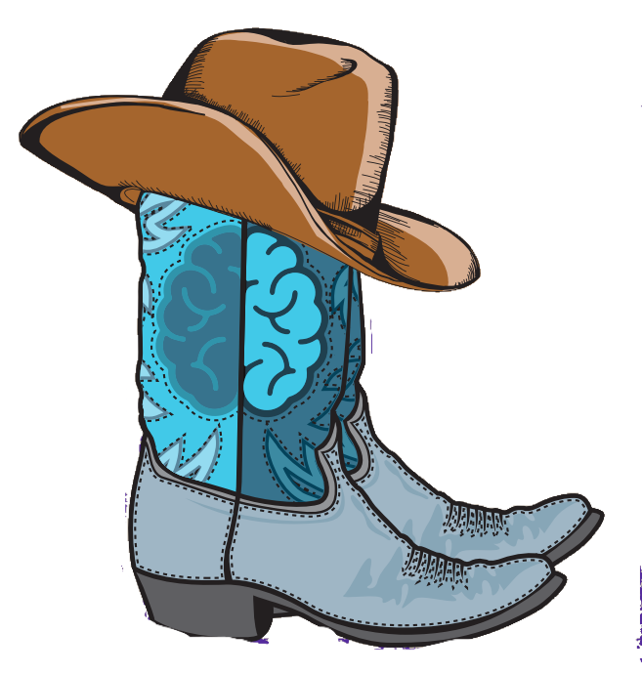


Developmental and Epileptic Encephalopathy:
A Primer
(aka: The Epileptic Encephalopathy story-From Dr. West to Henri Gastaut to Charlotte Dravet and beyond)
M. Scott Perry MD
Head of Neurosciences
Jane and John Justin Institute for Mind Health
Fort Worth, TX, USA

Slide 2
Disclosures
Speaking: Zogenix/UCB, NobelPharma, Marinus
Consulting: Bright Minds, Marinus, Stoke, Eisai, Biomarin, Greenwich, Taysha
Research (funds paid to Cook Children’s): Zogenix/UCB, Stoke, Encoded, Neurocrine, Takeda, Marinus

Slide 3
Agenda/Objectives
Part 1: Differentiate the concepts of developmental, epileptic, and developmental AND epileptic encephalopathies and how differentiation may impact therapy.
Part 2: Discuss the multifactorial manifestation of DEE - seizures and beyond, through the prototype of Dravet syndrome.
Part 3: Explore the value of specific syndrome/etiology recognition to treatment and outcomes over time.

Slide 4
A Little History…
1841 – Dr. West, in letter to the editor of Lancet, described the first epileptic encephalopathy
1965 – Dr. Dravet coined the term “epileptic encephalopathy” in her thesis describing the impact of epileptiform abnormalities in LGS
2001 – ILAE Commission for Classification included several syndromes under epileptic encephalopathy category
2010/2017 – Further defined to differentiate developmental AND epileptic encephalopathy
Notes:
2010 – 2017 – term DEE introduced as multiple genes responsible for EE were identified and it was understood that the underlying gene had impact on development exclusive of epileptiform activity.

Slide 5
What’s in a name? Differentiating DE, EE, DEE
Developmental encephalopathy
  A condition whereby developmental delay or intellectual disability is present, due to a non-progressive brain state whereby co-existing epilepsy may occur.
  Etiology: often static insult, earlier in life (i.e. HIE)
  Age of onset: in utero/perinatal
  Clinical features: normal to focal/systemic neurological features
  EEG: often abnormal, nonspecific
  Cognition: abnormal throughout, regardless of seizure control

Slide 6
What’s in a name? Differentiating DE, EE, DEE
Epileptic encephalopathy
  A condition whereby abundant epileptiform abnormalities and/or high seizure burden contributes to cognitive regression¹
  Etiology: varies based on cause of seizures (i.e. CSWS)
  Age of onset: any age (most occurring in childhood)
  Clinical features: most often normal
  EEG: abnormal, but can return to normal or improve with treatment
  Cognition: can be normal followed by regression with improvement if seizures/EEG improve
1. Berg AT, et al. Epilepsia 2010;51:676-85
Notes:
CSWS = SWAS

Slide 7
What’s in a name? Differentiating DE, EE, DEE
Developmental and Epileptic encephalopathy
  A condition where cognitive development and behavior is impaired independently to epilepsy onset, and epilepsy is characterized by high seizure frequency and epileptiform abnormalities which further impact cognitive/behavioral state.¹
  Etiology: varies, often genetic and/or structural (i.e. Dravet, TSC)
  Age of onset: any age (most occurring in childhood)
  Clinical features: Focal/systemic neurological findings or normal
  EEG: abnormal (though can be normal early in course)
  Cognition: can be normal initially, followed by delay and/or regression. Some improvement may occur with seizure control, but not normalization
1.Scheffer IE, et al. Epilepsia Open 2016;1:37-44
Notes:
Adult exceptions – some progressive myoclonic epilepsies

Slide 8
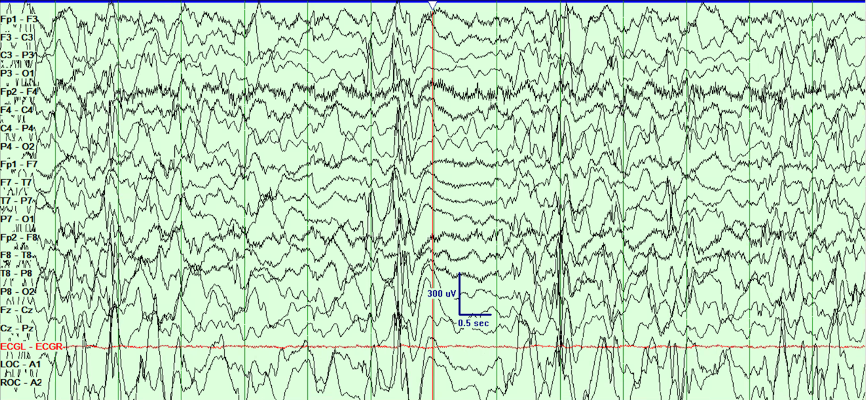
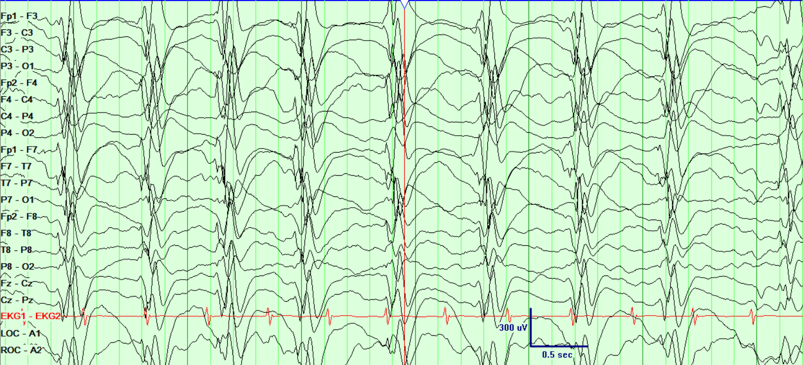
Evaluation
Clinical History
EEG – certain electroclinical patterns will exist
  Ohtahara
  West
  Lennox Gastaut
  CSWS
Imaging
Metabolic testing
Genetic testing
Notes:
Metabolic testing may be most useful in the very young where treatable conditions such as b6 deficiency may present
Clinical history particularly important in older patients where the course of the epilepsy may reveal the diagnosis AND in patients where development has regressed/plateaued where timing of this clinical finding with epilepsy/EEG history may inform treatment decisions

Slide 9
Evaluation
Genetic Testing
  Early identification of etiology
  Shortened duration to diagnosis
  Informed treatment decisions, disease-specific management
  Counseling
Notes:
Testing often in the form of next generation sequencing via whole exome or gene panels

Slide 10
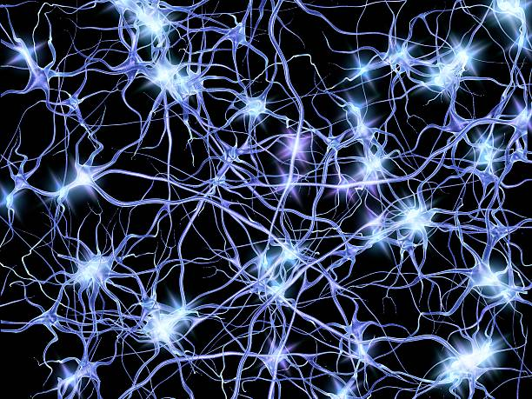
Uncontrolled Early Life Seizures Adversely Impact Neurodevelopment
  Early onset and DRE = lower full scale IQ (Berg et al 2012)
  Developmental declines are associated with: -onset < 1 year of age
    -preexisting developmental delay
    -identified etiology
    -DRE (Berg 2019)
IED may transiently adversely impact cognitive processing – both local and distant
Competing networks – epileptic vs cognitive
Maturational impact – altered neurogenesis, synaptic reorganization
Neuroinflammation
Kalser J and Cross H. Curr Opin Neurol 2018;31:216-222.
Notes:
Inflammation is a natural response to various brain insults including seizures and may lead to additional seizures and cognitive/developmental impact – which in turn may explain progressive declines. Neuroinflammatory responses also change somewhat with age and may explain some of the age-specific electroclinical syndrome manifestations

Slide 11
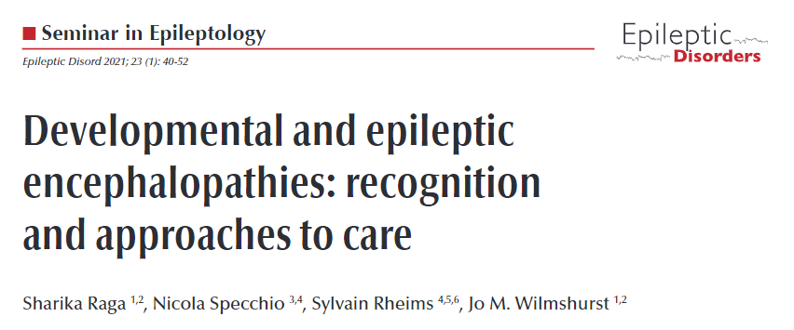
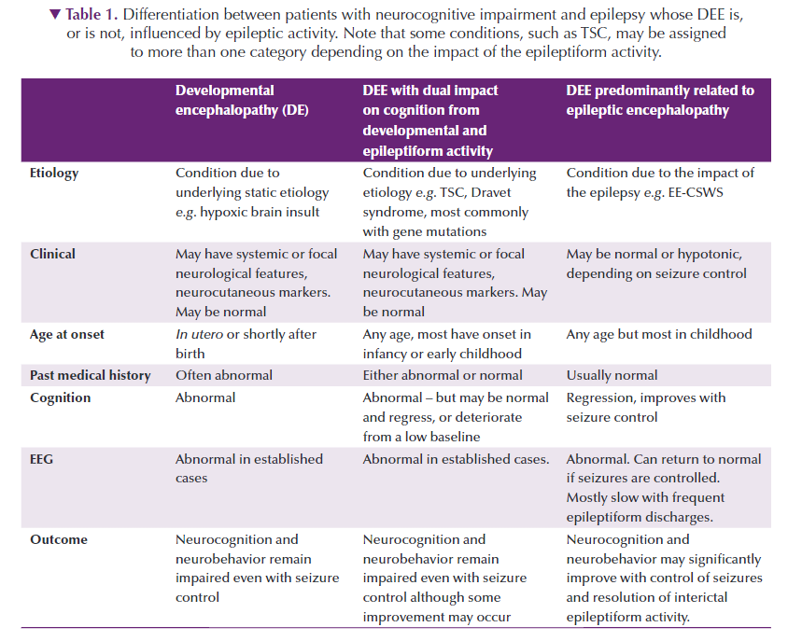
Defining the problem

Slide 12
Implications to Care
  How aggressive do you treat, when and with what?
  Balancing seizure control to adverse effects
  Cognitive/behavioral prognosis
  Prioritizes and directs research

Slide 13
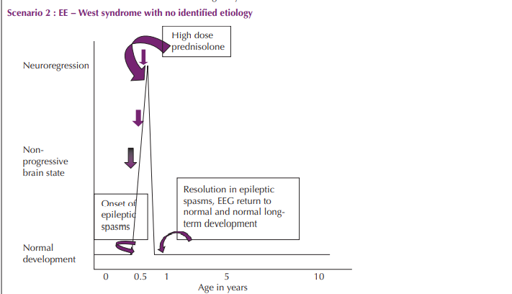
Illustrative Cases
Normal development with regression related to the epilepsy
Treatment should be aggressive
Normalization/improvement in seizures and EEG leads to developmental improvements

Slide 14
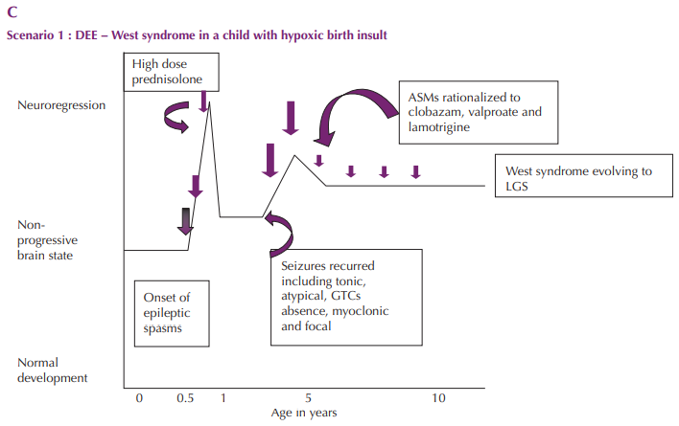
Illustrative Cases
Development abnormal prior to seizure onset, but worsens
Treatment is still aggressive, but normalization of development isn’t expected
Notes:
Highlight PERC data that showed this population was more likely to not receive standard of care, yet response in this group for seizure control was not significantly different from those without etiology – suggesting opportunity for practice improvement.

Slide 15
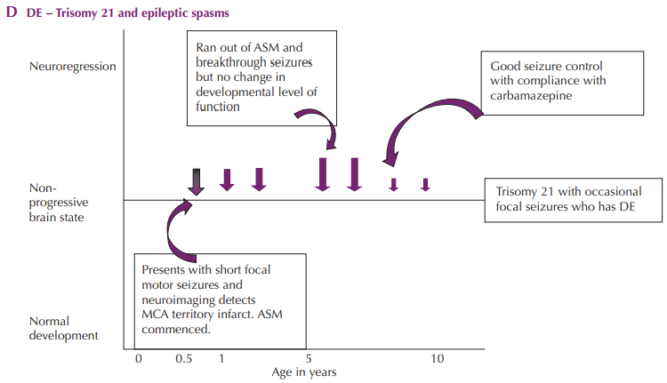
Illustrative Cases
Development abnormal initially and remains unchanged
Prognosis for development is independent of seizure control

Slide 16
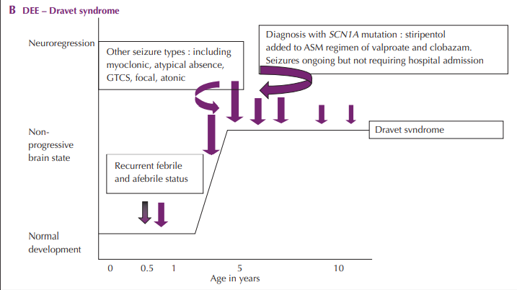
Illustrative Cases
Development is adversely impacted by seizures and etiology
Appropriate and successful treatment may alter course of development, but not normalize
Notes:
Studies are not completely conclusive in showing a connection between seizure control and cognition, however, prior work has shown that exposure to contraindicated meds (Na Channel drugs) was associated with poorer cognitive/developmental outcomes. Likewise, recent phase 3 trials of fenfluramine demonstrated improvements in (or lack of decline) in executive functioning via BRIEF in responders.

Slide 17
Define the treatment goal
Improve Development/Cognition
Seizure control
How much?
What seizure type?
Improved QOL
Stop Regression
Reduce/Prevent injuries
Reduction of meds
Notes:
What is the expected course of the underlying etiology?
Within an etiology (particularly genetic) are there different courses based on functional consequences of the variant?
Is the treatment different depending on the phenotype (and relationship to functional consequence of the gene)?
What is the goal of your therapy?

Slide 18

The Evolution of a DEE
From http://www.squareinchhouston.org/newsletter/2018/2/1/metamorphosis

Slide 19
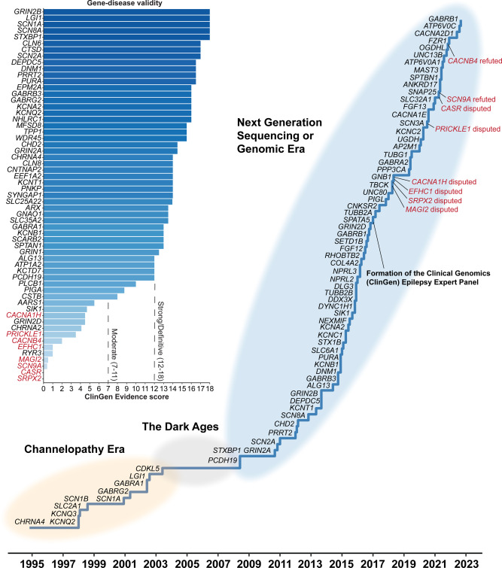
The List is Long and Growing…
Early Recognition
Early Prediction
Early Intervention
Effective Treatment
Prevent>>Reverse
Xian J and Helbig I. Eur J Ped Neuro 2023
Notes:
Not only is the list of genes responsible for epilepsy increasing, but the phenotypic spectrum for many genes continues to increase (example scn8a). The management options are growing as well.
Recent history has brought improved understanding of the phenotypic spectrum of disease, natural history of disease, and new treatment options informed by timing for best outcomes

Slide 20

It all began in 1978…
Described¹ as severe myoclonic epilepsy of infancy, renamed for Dr. Charlotte Dravet in 1989
Initial clinical criteria:
  Family history of epilepsy or febrile convulsion
  No prior history of disease
  Seizures year 1: generalized or unilateral febrile clonic seizures
  Later appearance: myoclonic jerks and partial seizures
  EEG: generalized SW and polySW, photosensitivity, and focal abnormalities
  Developmental delays by year 2
  Simultaneous ataxia, pyramidal signs, and interictal myoclonus
  Resistance to all forms of treatment
  Intellectual deficiency and behavioral disorders in all affected children
1. Dravet C. Les epilepsies graves de l’enfant. Vie Med 1978;8:543-8.
Notes:
Dravet syndrome is primarily a clinical diagnosis
Partial seizures (now called focal dyscognitive)

Slide 21
And then it evolved…
Modified in 2010
  Family history of epilepsy or febrile convulsions is variable
  Initial seizures are not always generalized or unilateral clonic but may be focal or myoclonic
  Initial seizures are not always febrile
  Atypical absences and absence status frequently appear
  Photosensitivity may be associated with pattern sensitivity
  Neurological signs are not always present
  MRI is normal at the onset
  Cognitive deficiency and behavioral disorders are present in all affected children but of variable degrees
Notes:
Dravet syndrome is a spectrum which has only grown with time, increased understanding, and increasing genetic testing revealing the full cohort of presentations associated with sCN1A mutations
Family history varies 25-71%
Neurological signs: ataxia (60%), pyramidal signs (20%), and interictal myoclonus (36-85%)
Incidence: 1 per 20000¹ to 1 per 40000²
Infants are most often healthy and developmentally normal prior to onset
Family history of epilepsy or febrile seizures is variable (25-70%)

Slide 22

EPILEPSY
COGNITIVE/BEHAVIORAL
SLEEP
GAIT/ORTHOPEDIC
FEEDING/GASTROINTESTINAL
SOCIAL
AUTONOMIC
SUDEP

Slide 23
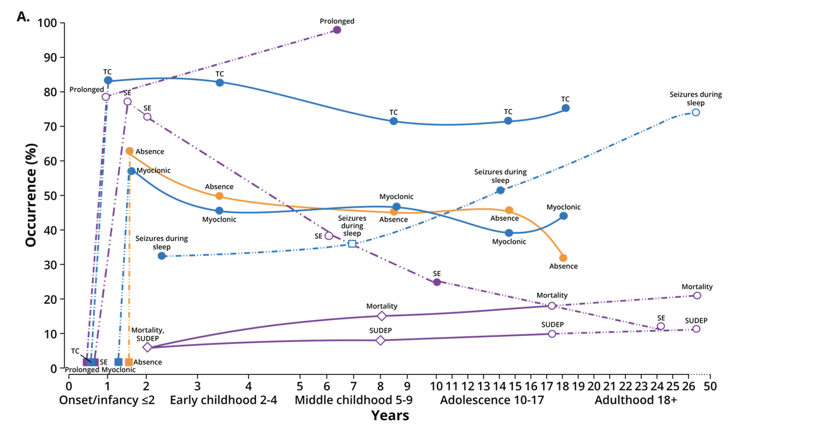
Challenges-Seizures
Juandó-Prats C, et al. DRAVET ENGAGE. Parent caregivers of children with Dravet syndrome: Perspectives, needs, and opportunities for clinical research, Epilepsy Behav. 2021

Slide 24
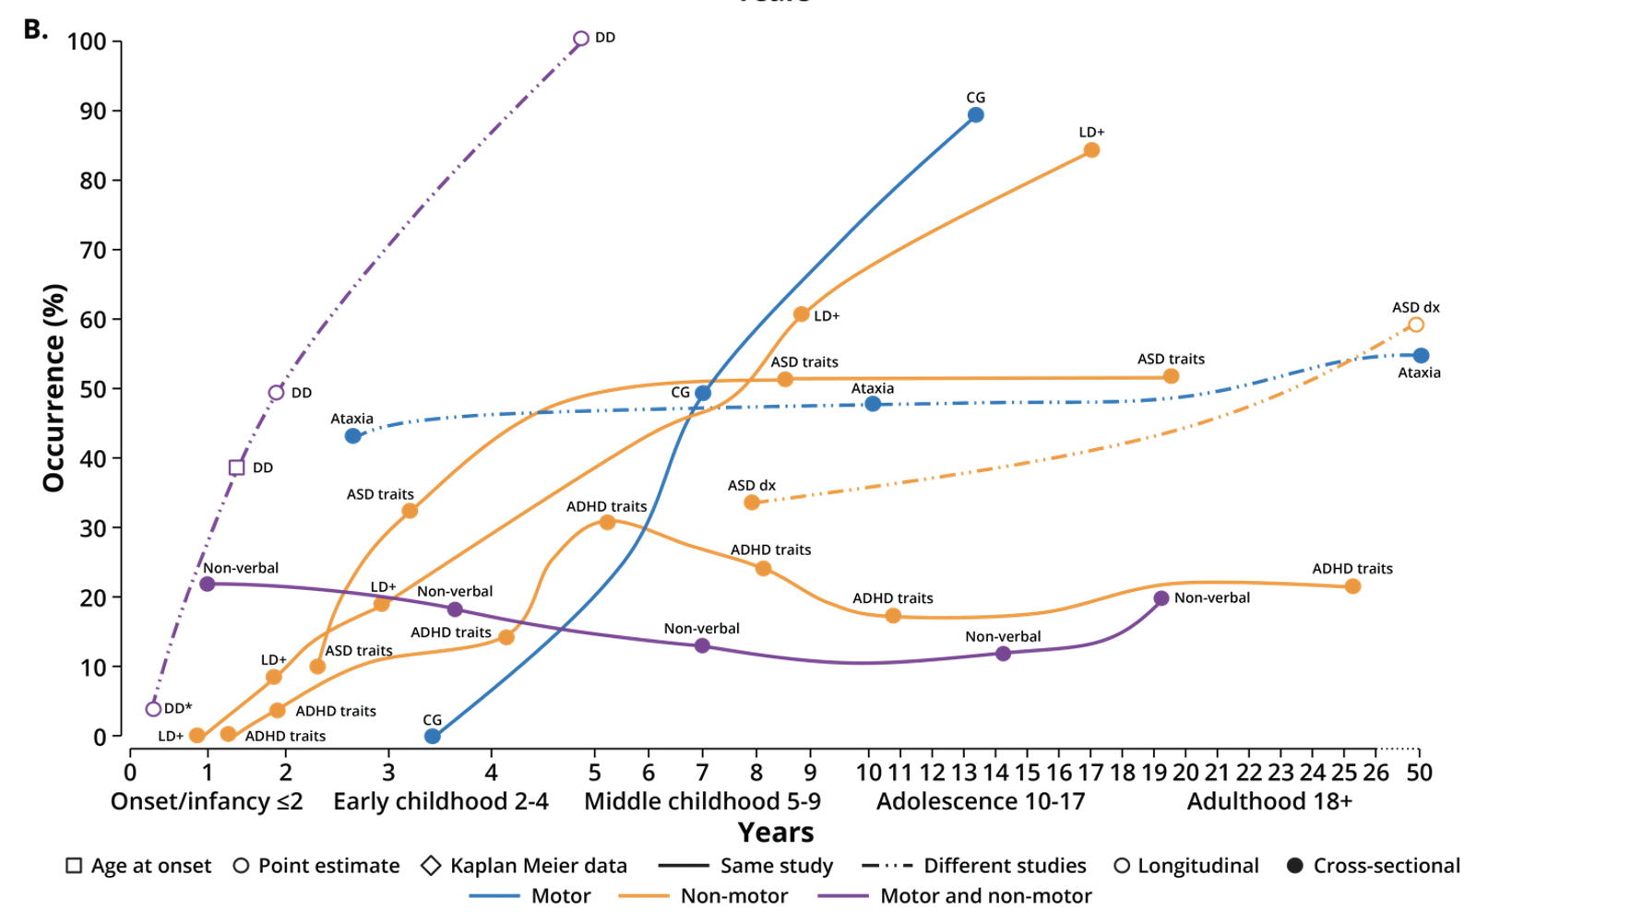
Challenges-Comorbidities
Juandó-Prats C, et al. DRAVET ENGAGE. Parent caregivers of children with Dravet syndrome: Perspectives, needs, and opportunities for clinical research, Epilepsy Behav. 2021

Slide 25
Treatment Evolution Over a Decade
Increased awareness of Dravet
Increased access to genetic testing
  Earlier diagnosis
  Avoidance of contraindicated treatments
  Improved seizure control
  Better cognitive/developmental outcomes
Evolution of EXPERIENCE

Slide 26
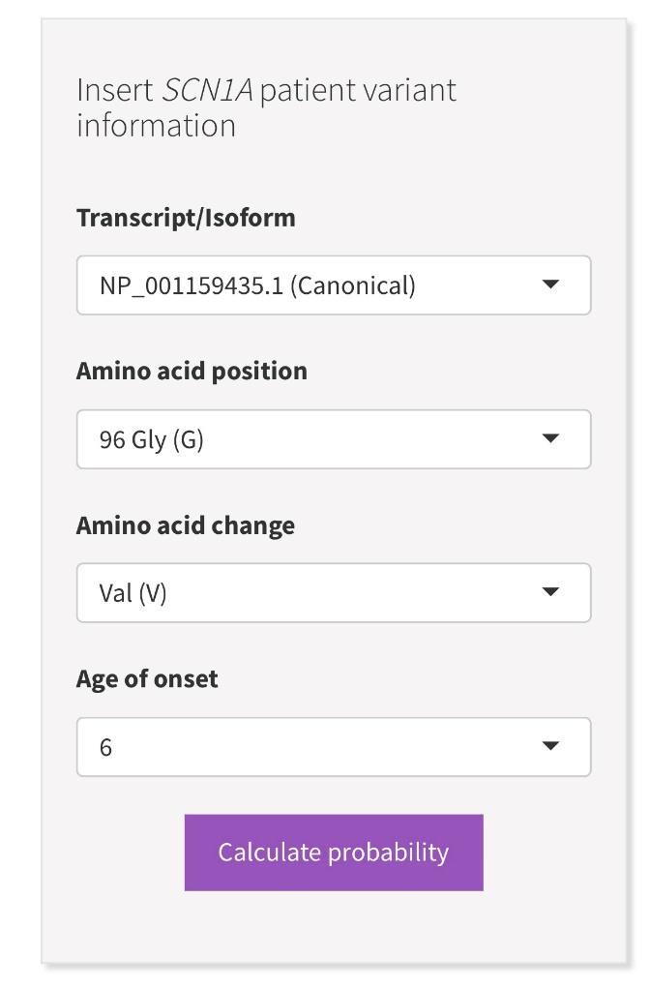
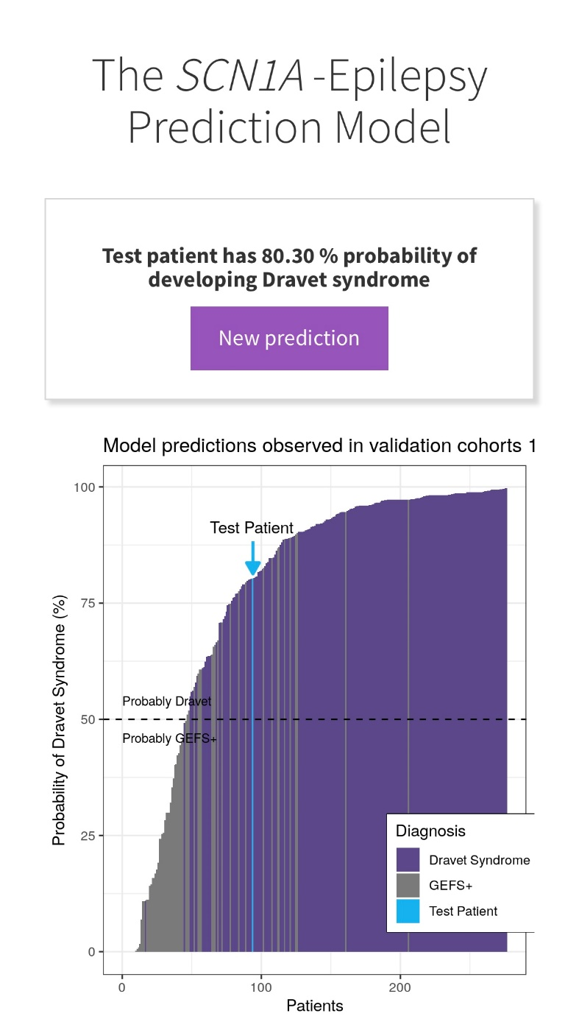
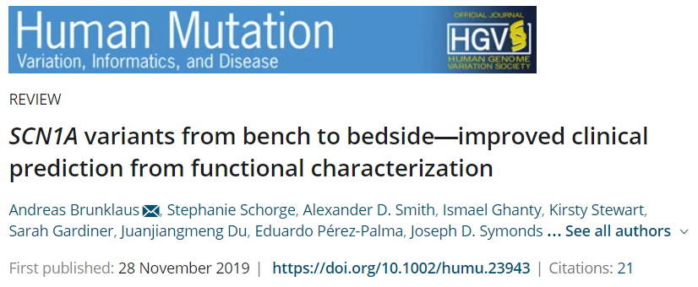

Early Prediction
Early genetic testing offers opportunity to speed up diagnosis/treatment
Altering course requires predicting outcome in advance of symptoms
Notes:
Early prediction via biomarkers (think TSC and treating prior to seizures) or via functional consequence prediction

Slide 27
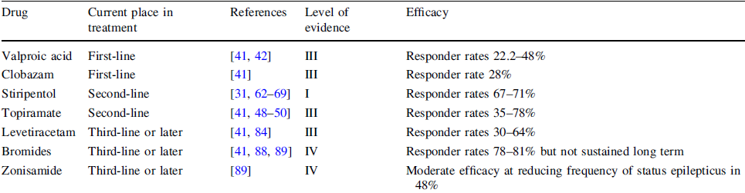
Early (and effective) Treatment Evolution Over a Decade
Consensus guidelines
  2017 North Amer Consensus (Wirrell et al Ped Neuro; 68: 18-34)
  2019 European Consensus (Cross et al, Epilepsia; 60:suppl3-s39-48)
Evolution of EVIDENCE
Knupp and Wirrell, CNS Drugs 2018

Slide 28
Dravet Treatment Evolution Over a Decade
Class I Clinical Trial Data Leading to FDA Approvals
  Stiripentol 2018
  Cannabidiol 2018
  Fenfluramine 2020
Evolution of EVIDENCE
Drug | Class of Evidence | Overall Sz Reduction | Responder Rate
Fenfluramine | I | 79% | 70%
Stiripentol | I | 84% | 67-71%
Cannabidiol | I | 39% | 43%

Slide 29
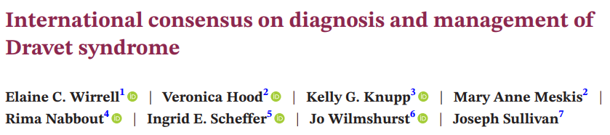
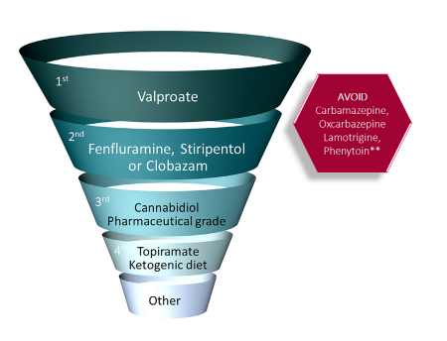
Early (and effective) Treatment Evolution Over a Decade
Consensus guidelines
  2022 International Consensus, Epilepsia
Evolution of EVIDENCE

Slide 30
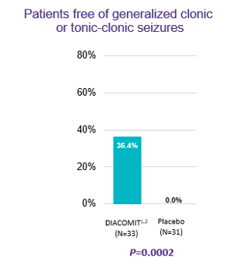
Treatment Evolution Over a Decade
Seizure Freedom (or at least significant reduction is possible)
  Stiripentol FDA approved 2018
  Cannabidiol FDA approved 2018
  Fenfluramine FDA approved 2020
Evolution of EXPECTATIONS
Stiripentol
Fenfluramine >75% Reduction
57%
25%
With 0-1 seizure
2.6%

Slide 31
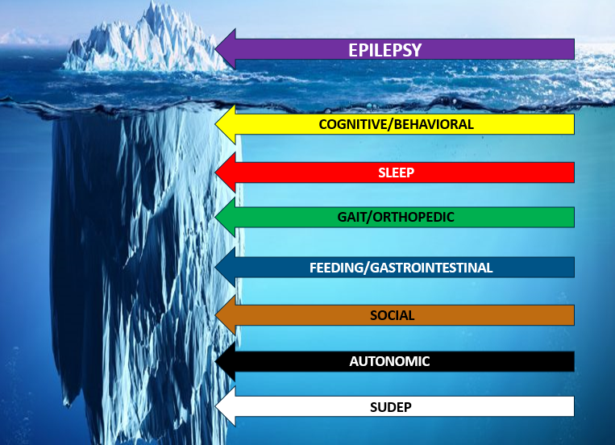
Treatment Evolution Over a Decade
Evolution of EXPECTATIONS
Epilepsy is more than seizures
Other symptoms impact patient and caregiver QOL
In the setting of better seizure control, other symptoms rise to the top of concern

Slide 32
DEE Treatment/Prognosis Lifecycle
Increased Awareness/Diagnosis
New Expectations
Earlier Diagnosis
Earlier Treatment
Effective Therapies

Slide 33
Is there opportunity to alter the course?

Slide 34
Illustrative Cases
Better seizure control is helpful
Can we move the needle further
Timing and Treatment

Slide 35
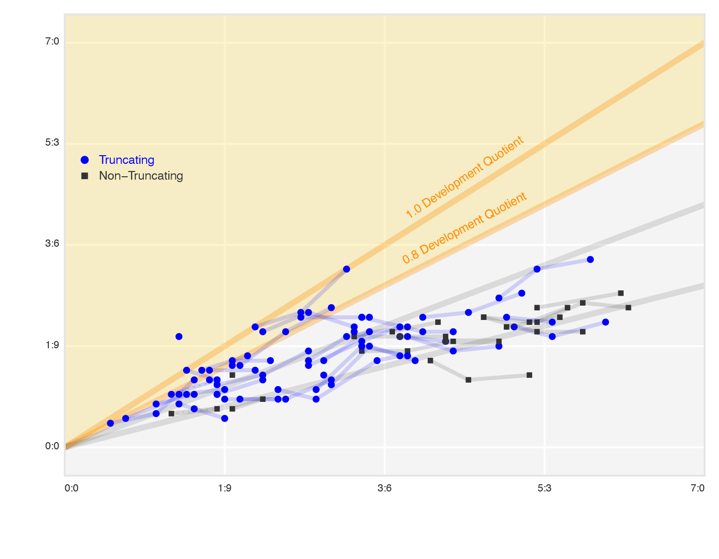
The ENVISION Study: International, Prospective Natural History Study in Young Children with SCN1A+ Dravet Syndrome 1.087 2022 AES
Vineland-III: ABC Scores show deviation from neurotypical development at age 2 years, with a drop in standard scores by 1 SD in <3 years
Additional gross motor assessments show differing sensitivities to change but consistently demonstrate slow skill acquisition before age 2.5 years
>1.0
Communication, daily living skills, and socialization are significantly affected in children 2 years and above;
their ability to relate to others and engage in play is increasingly compromised over time
7:0
Baseline Vineland-III ABC DQ (%)
n 52
Mean (SD) 62.2 (21.4)
Median (range) 55.4 (36–153)
0.8 to 1.0
5:3
● Truncating
■ Non-truncating
Developmental Quotient 1.0
0.6 to 0.8
Developmental Quotient 0.8
Age equivalent (Y:M)
3:6
0.4 to 0.6
1:9
Age, 6:2 vs 2:5 DQ: 39%
< 0.4
0:0
Age equivalent increases by 0.3 years per chronological year (P<0.001)
0:0
1:9
3:6
5:3
7:0
Executive functioning measured by the BRIEF-P shows marked deficits, particularly in the domains of inhibitory self-control and metacognition
Chronological age (Y:M)
Notes:
Multicenter, prospective, 2-year observational study​ of young children with SCN1A+ DS (Table 1), conducted in 17 sites across the US, Australia, UK, and Spain
~50​ participants assessed every 3 months (virtual assessments and clinic visits), divided among age groups: 6–36 months; >36–48 months; and >48–60 months
Objectives
Characterize the current seizure burden in DS managed with
contemporary ASMs
Measure the development of non-seizure manifestations
of DS and their relationship with seizure burden
Identify appropriate assessment tools and seizure and neurodevelopmental endpoints for
clinical trials

Slide 36
DEE Treatment/Prognosis Lifecycle
Increased Awareness/Diagnosis
New Expectations
Earlier Diagnosis
Earlier Treatment
Effective Therapies

Slide 37

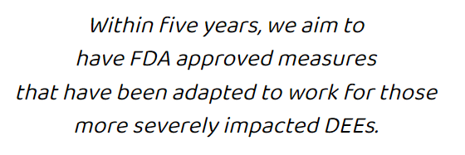
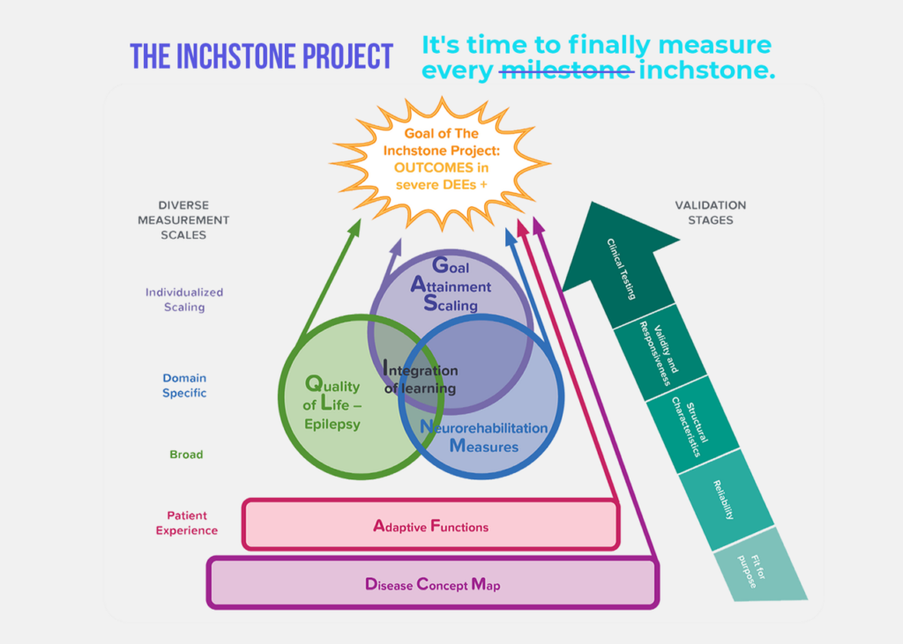


Slide 38
Mind the Etiology, Not Just the Syndrome
Is the underlying reason for the epilepsy amenable to your chosen therapy?
There is a difference between West syndrome secondary to hemimegalencephaly and West syndrome in the setting of SCN8A.
Notes:
Don’t be a lumper with DEE –instead think of it as DEE secondary to an etiology

Slide 39
Mind the Symptoms of the Syndrome
Is the presentation amenable to your chosen therapy?
There is often a difference between SCN8A with primarily absence (LOF) versus severe DEE of SCN8A (GOF)
Notes:
Don’t be a lumper with DEE –instead think of it as DEE secondary to an etiology

Slide 40
Mind the Timing of Treatment
1 oz
PREVENTION

Slide 41
Conclusions
-Understanding whether you are dealing with DE, EE, or DEE is essential
-Early recognition, particularly via anticipation, allows for early treatment and potentially improved outcomes
-Effective treatment (of more than seizures) is necessary to alter the course of DEE

Slide 42

QUESTIONS?

Slide 43
Extra slides

Slide 44
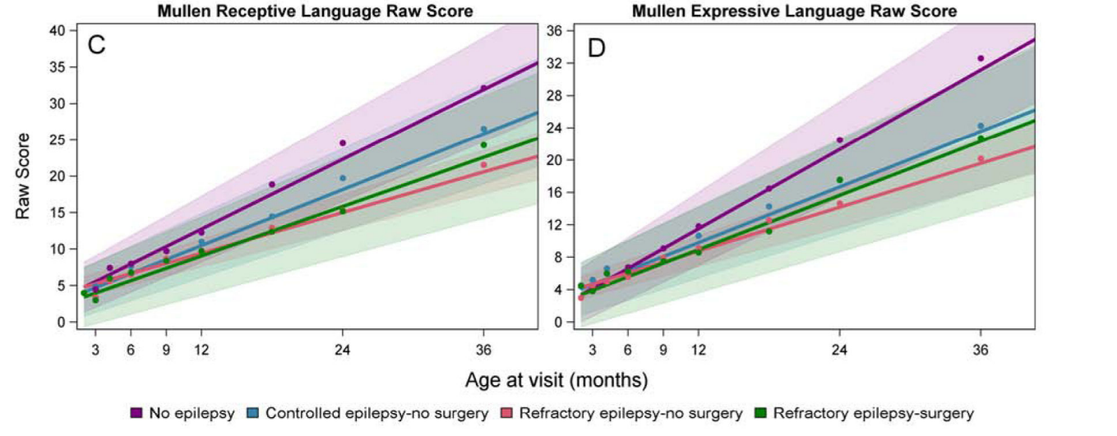
DEE Secondary to Multifocal Cortical Lesions Should be Considered for Epilepsy Surgery - TSC
Pilot study of early surgery in TSC
  19 children < 2y
  Surgery vs no surgery vs controlled epilepsy vs no epilepsy
Surgery group
  50% with Engel I or II outcome
  Trajectory of development improved, notably for language
  Motor complications may limit measures of dev gain
Grayson LE et al. Ped Neuro 2020;109:39-46.
Notes:
Kids with refractory epilepsy and surgery had earlier onset and more meds and lower developmental scores

Slide 45
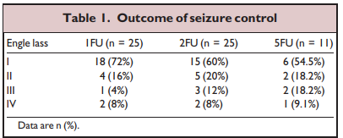
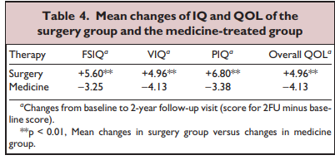
Even Delayed Surgery May Achieve Improvements
25 TSC cases with > 5y post-op follow up
Mean age sz onset: 1.8y
Mean age surgery: 14.3
Age at surgery (p<0.05) and duration (p<0.01) predicted seizure freedom
IS, onset < 1y, surgery type did not predict sz freedom
Liang S et al. Epilepsia 2010;51:2316-2321
Notes:
Surgery was performed 12 years after seizure onset.
Fallah et al showed lobectomies/larger resections (i.e. not tuberectomies) were associated with seizure freedom.

Slide 46
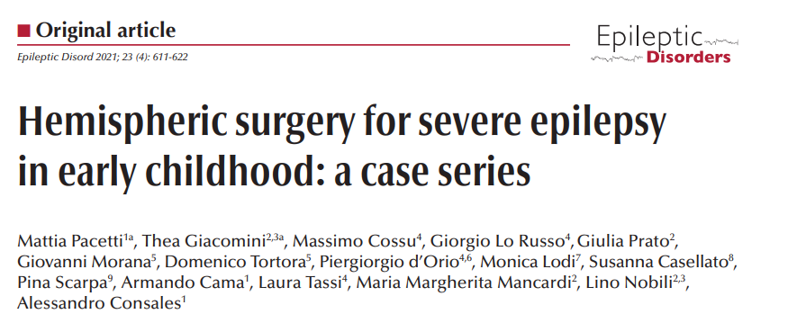
DEE Secondary to Focal Cortical Lesions Should be Considered for Epilepsy Surgery
14 children with hemispheric epilepsies (hemimegalencephaly, porencephalic cyst, perinatal ischemia)
Mean age onset: 1.5m
Mean age surgery 14.5m
Outcome mean 31m
  71% Engel 1
  79% reduced/discontinued ASM
78%
Developmental Outcome
Pre: Severe DD 10, Moderate 2, Mild 2
Post: 5 Severe ->Mod; 6 unchanged; 2 Mild->Mod
Notes:
11/14 either remained stable in development or improved.

Slide 47
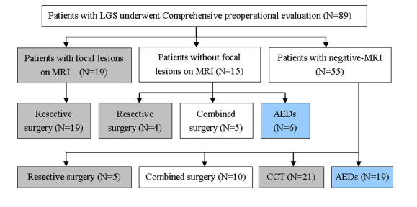
Surgery Offers Superior QOL, IQ, and Seizure Control Compared to Additional Meds
107 pt with LGS undergoing surgery evaluation
  64 surgery (resection or CC+resection), 25 meds only
  IQ (limited testing) Improved for 67% after surgery vs 4% on meds
  IQ worsened 12% after surgery and 43% on meds
  QOL improved 72% after surgery vs 4% on meds
  QOL worsened 7% after surgery vs 48% on meds
SEIZURE FREE OUTCOMES
Surgery | Meds
1Y: 70% | 4%
3Y: 60% | 0%
5Y: 55% | 0%
Ding P et al 2016
Notes:
6 showed >15 points of IQ gain. 2 showed decline

Slide 48



The First Clues…
Years 0-1
Initial seizure between 5-8months - may or may not be associated with fever/modest hyperthermia
Clonic, generalized, unilateral clonic type
Duration tends to be long, often evolving to status epilepticus
EEG is most often normal at onset
Initial diagnosis is often febrile seizure
Seizures often recur in weeks to months
Notes:
-peak age of onset 6 m; only rare exceptional cases have reported age of onset after 1 y (Kearney et al 2006)
-hot water baths as detailed by the Japanese in their articles of seizures associated with Hot water immersion.
-convulsive seizures may occur in the absence of fever: reported in 28% (Okhi et al 1997), 35% (Dravet et al 2005) and 65% (ragona et al 2010)
In Dravet’s series – most patients presenting with afebrile seizures did so in the setting of vaccinations or illness
Duration > 20 minutes in 25% (Dravet 2005) to 49% (Ragona 2010)
EEG most often normal in wake/sleep – though focal or generalized slowing, rarely Gen sw or photosensitivity may be seen – especially if recorded soon after a seizure.

Slide 49
The Evolution…
Years 0-1
Years 1-4
Other seizure types appear
  Alternating hemiclonic
  Generalized tonic clonic
  Myoclonic
  Absence/atypical absence
  Focal dyscognitive
  Tonic seizures are rare
EEG demonstrates generalized spike wave/polyspike wave
Notes:
-Years 1-4 sometimes called the “catastrophic” period which corresponds to worsening of seizures, progressive cognitive decline or stagnation of development, evolving neurological signs, etc.
-Unilateral seizures – often alternating in appearance – are the most characteristic. Often prolonged evolving to status and often accompanied by postictal paralysis
-GTC seizures are present throughout evolution – most often truly focal seizures with secondary generalization.
-myoclonic seizures arise 1-5 years (mean 17 months). May be massive with whole body involvement/fall/drop things, or more subtle with only brief head nod. Some cases occurring throughout the day while in others primarily manifest around awakening. Myoclonic seizures may not be present in all and the overall frequency may be less in those not exposed to sodium channel AEDs.
-absence seizures begin between 4m-6y. Often intermixed with myoclonic type seizures – eyelid fluttering/myoclonia common. Obtundation status can occur in between 40% (Dalla bernadina 1997) and 30% (Dravet 2005).
-Seizures are very often characteristically associated with provoking factors: modest hyperthermia, pattern/light sensitivity, noisy environments, exercise, are other reported triggers in some.

Slide 50
The Evolution…
Years 0-1
Years 1-4
Developmental delays become evident
Regression may occur
Behavioral concerns of inattention and hyperactivity arise
Neurological signs appear
  Hypotonia
  Ataxia
  Pyramidal signs
Notes:
-Years 1-4 sometimes called the “catastrophic” period which corresponds to worsening of seizures, progressive cognitive decline or stagnation of development, evolving neurological signs, etc.
-While gait may develop at a normal time, it is unsteady and physiologic ataxia fails to improve with age. Language starts on time, but is slow to develop – many not developing short phrases/sentences, fine motor coordination is poor

Slide 51
The long term
Years 0-1
Years 1-4
Years 5-Adulthood
Seizures persist into adulthood
  Rarely prolonged as the patient ages
  Mostly occur in sleep
Cognitive delay persists
Gait abnormalities persist
Mortality by adulthood 15%
Notes:
-Gait is a triple flexed crouched gait – almost parkinsonian in its character. The gait make ambulation over distances difficult, though adults may still be able to ambulate short distances
-Mortality into adulthood is 15% - mostly from seizure related injury or SUDEP

Slide 52
The comorbidities
Cognitive Development normal initially
  Steep falling curve over the first 4 years
    Relationship to seizures, medications, and the underlying gene mutation still unclear
  Cognitive impairment: mild 34%, moderate 41%, severe 26%¹
Behavior
  Hyperactivity/inattention
  Autistic traits
1. Caraballo RH, Fejerman N. (2006) Dravet syndrome: a study of 53
patients. Epilepsy Res 70:231–238.
Notes:
– epileptic encephalopathy vs channelopathy (or both?)
Dravet syndrome is an epileptic encephalopathy: From the ILAE definition “the epileptic activity itself may contribute to severe cognitive and behavioral impairments above and beyond what might be expected from the underlying pathology alone and that these can worsen over time.” though whether the encephalopathy is purely related to the underlying cause, the seizures, the treatment, or a combination is not clear.
Longitudinal studies in infants with febrile seizures followed for emergence of Dravet show impairments in precognitive skills (i.e. visual processing, fixation, tracking) are abnormal even before the emergence of seizures – suggesting some congenital subclinical component to cognitive delays when baseline assessments may seem normal. (Chieffo et al 2011) This underscores the view of Dravet as a channelopathy where the mutation itself is the cause of some of the features prior to the onset of seizures and epileptic encephalopathy.
Cognitive decline becomes evident in the 2nd year – though it is less of a decline and more a stagnation with the developmental quotient remaining stable with a widening discrepancy between developmental age and chronological age.
The etiology of this decline is still unclear. Some studies suggest the epilepsy profile (i.e. earlier appearance of absence and myoclonic seizures) may lead to worse outcomes (though not statistically significant in Ragona 2011 study). One might think convulsive seizures and status epilepticus may play some role – though that is yet to be confirmed. Recent study (de Lange et al 2018 epilepsia) demonstrated a correlation between longer duration of exposure to contraindicated medications and lower cognitive outcomes.
Behavior is manifest as aggressiveness, impulsivity which along with their cognitive and motor deficits may further impact social and functional development
After 6 years, there may be some positive improvement in cognition in that it stagnates and adaptive behaviors may show some improvement

Slide 53
The comorbidities
Sleep
  75-82% of parents report sleep concern^{1,2}
  Difficult sleep initiation and transition are most common
  Difficulty maintaining sleep (often seizure related)
  Extrinsic vs intrinsic sleep dysfunction
Knupp K, et al. Ped Neurology 2017;76.
Licheni SH, et al. Dev Med Child Neurol 2018,60.
Notes:
In parental survey 1 – 65% report difficulty falling asleep, 69% difficulty awakening from sleep and 53% short sleep time.
In survey 2 – 39% reported difficulty with sleep initiation or maintenance, 33% with sleep disorder breathing
Sleep problems commonly seen in Dravet are similar to those experienced in children with ADHD which are primarily environmental and behavioral in origin.
However, evidence from mouse models of Dravet suggest there is an intrinsic dysregulation of sleep secondary to the scn1a mutation.

Slide 54
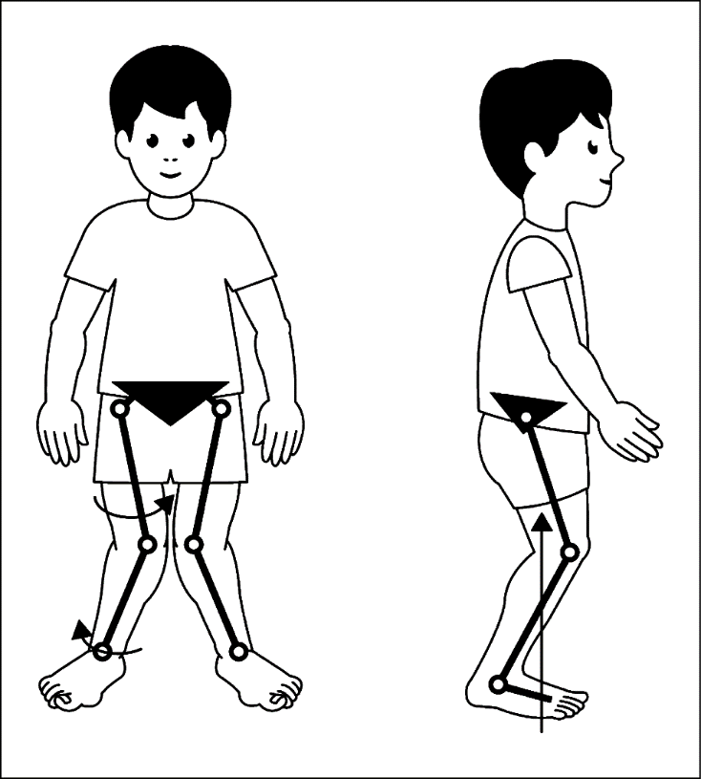
The comorbidities
Orthopedic
  Progressive gait deterioration and skeletal malalignment beginning around 6y¹
  Crouched gait, loss of foot arch, external tibial torsion
  Decreased mobility and endurance over time
  Osteopenia
1. Rodda JM et al. Arch Neurol 2012
Notes:
Most with Dravet learn to walk within normal time frame (mean 16-17months)
Hypotonia and some amount of ataxia may be present early on.
Etiology of decline in gait is unclear. It may be related to dysfunctional GABA interneurons within Purkinje cells of cerebellum as has been seen in some mouse models (though these are young mice and do not reflect the same pattern seen in mature children with Dravet). Gait deterioration may be related to a motor neuronopathy (Gitiaux et al Neurology 2016).

Slide 55
The comorbidities
Gastrointestinal^{1,2}
  99% report problems with appetite
    Prolonged meal times, needing assistance with feeding, food fads
  40% report difficulty swallowing
  Constipation
Villas N et al Epil Behav 2017
Knupp K et al Ped Neurol 2017
Notes:
Constipation reported in over 50%

Slide 56
The comorbidities
Other
  Autonomic
  Endocrine – precocious puberty
  Immune – frequent infections
  Mortality¹ – early mortality in estimated 20% (SUDEP and SE most common cause)
1. Shmuely, S et al. Epil Behav 2016
Notes:
SUDEP and SE account for 80% of reported deaths in the literature related to DS. 50% SUDEP and 30% SE – much higher than other intractable epilepsies. Many die at younger age (73% < 11years) compared to other intractable epilepsies – possibly reflecting the severity of the epilepsy during this time frame of age in DS.

Slide 57
The comorbidities
Family impact^{1,2}
  Two thirds of caregivers report symptoms of anxiety/depression
  75% report concern for sibling impact
  Adverse impact on employment
  Average annual financial burden $106,000³
Campbell JD, et al. Epil Behav 2018
Villas N et al. Epil Behav 2017
Whittington MD, et al. Epil Behav 2018
Notes:
Two thirds report depression yet only 26% report they sought any therapy
43% report impact on work productivity and > 60% report losing, changing or quitting a job because of their child’s illness requiring > 10 visits per year

Slide 58
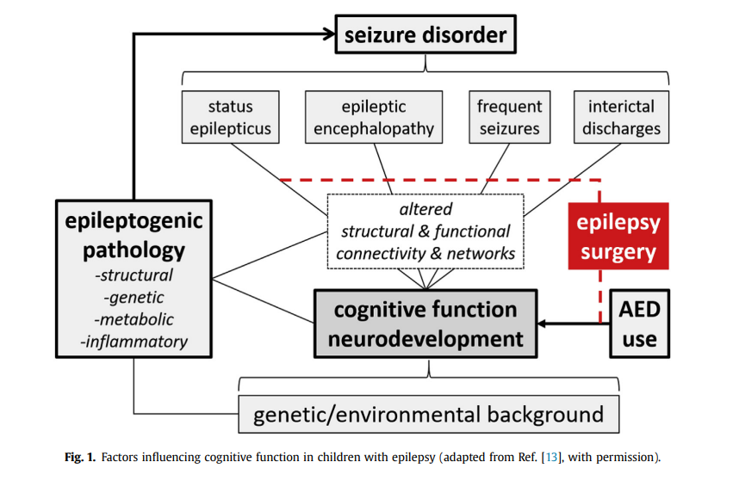
Figure credit: Braun KP. Eur J Ped Neuro 2020;24:40-42 and Braun KP Curr Opin Neurol 2017;30:140-7.

Slide 59
DEE Secondary to Focal Cortical Lesions Should be Considered for Epilepsy Surgery – West Syndrome
5 infants with refractory focal IS¹
Lesional MRI
Seizure free 6 y post-op
3 had pre-existing delays and did not decline
2 maintained normal development
5 infants with refractory IS²
Cryptogenic etiology
Parieto-occipital PET hypometabolism.
75% seizure free after surgery
All reported to make developmental progress post-op
1. Yum MS et al. Clin Neuro Neurosurg 2011;113:213-217
2. Chugani H et al Ann Neuro 1990;27:406-413.
Notes:
Stretch the evaluation beyond just MRI – PET, MEG, etc.
Lesional mri was malformation, perinatal stroke, TSC, astrocytoma

Slide 60
Lennox Gastaut Syndrome Responds to Epilepsy Surgery – Seizure freedom is possible!
Retrospective study 27 pt <18 yo with LGS undergoing resective surgery
  18(67%) with FCD, 4 (15%) encephalomalacia, 2 (7%) remote stroke, 4 nonlesional
  Surgery type: 10 multilobar, 11 single lobar, 6 hemispherectomy
  Outcome: 59% seizure free (2/4 nonlesional), 15% with > 90% reduction. 29% stopped all meds
  19% experienced no change
  22 (81%) showed developmental improvements (most Engel 1 or 2)
  Larger surgeries had better chance of favorable outcome.
Lee YJ et al 2010
Notes:
6 showed >15 points of IQ gain. 2 showed decline
Mean duration of epilepsy prior to surgery 6 y (range 1,5-12)
30% with infantile spasms

