Slide 1
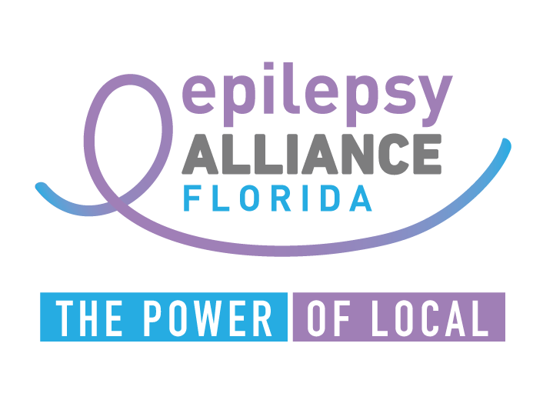
They seize in school and now there’s a law
How can we help them when they leave school
Patricia Dean APRN,MSN,CNRN
Immediate Past President, Board of Directors

Slide 2
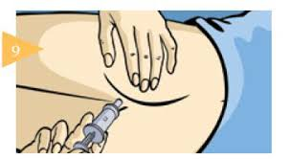
How It Began
DIASTAT (diazepam rectal gel) was approved on July 29, 1997

Slide 3
Florida’s Seizure Safety in School Law
An act relating to care of students with epilepsy or seizure disorders creating s. 1006.0626, F.S.; providing definitions; requiring a school to:
provide epilepsy or seizure disorder care to a student under certain circumstances;
providing requirements for the implementation of an individualized seizure action plan for a student with epilepsy or a seizure disorder; providing that an individualized seizure action plan remains in effect until certain criteria are met;
providing that implementation of such plan does not absolve or limit other specified duties of the school;
authorizing a school to provide training and supports to a student in the absence of such a plan; providing requirements for such plans; requiring a school nurse or appropriate school employee to coordinate the care of such students and verify the training of certain school employees relating to the care of the students; providing requirements for such training;
requiring the Department of Education to identify certain training courses on its website; requiring schools to provide specified information to certain school employees; providing an effective date

Slide 4
Florida’s seizure safety in school law
Legislation requires all public schools to:
Train school personnel on seizure detection and first aid response
Mandates Seizure Action Plans be on file for every student diagnosed with epilepsy or a seizure disorder, and require those plans be available to all personnel responsible for the student
Ensure the administration of medications approved by the FDA
Educate and train students about epilepsy and seizure first aid response

Slide 5



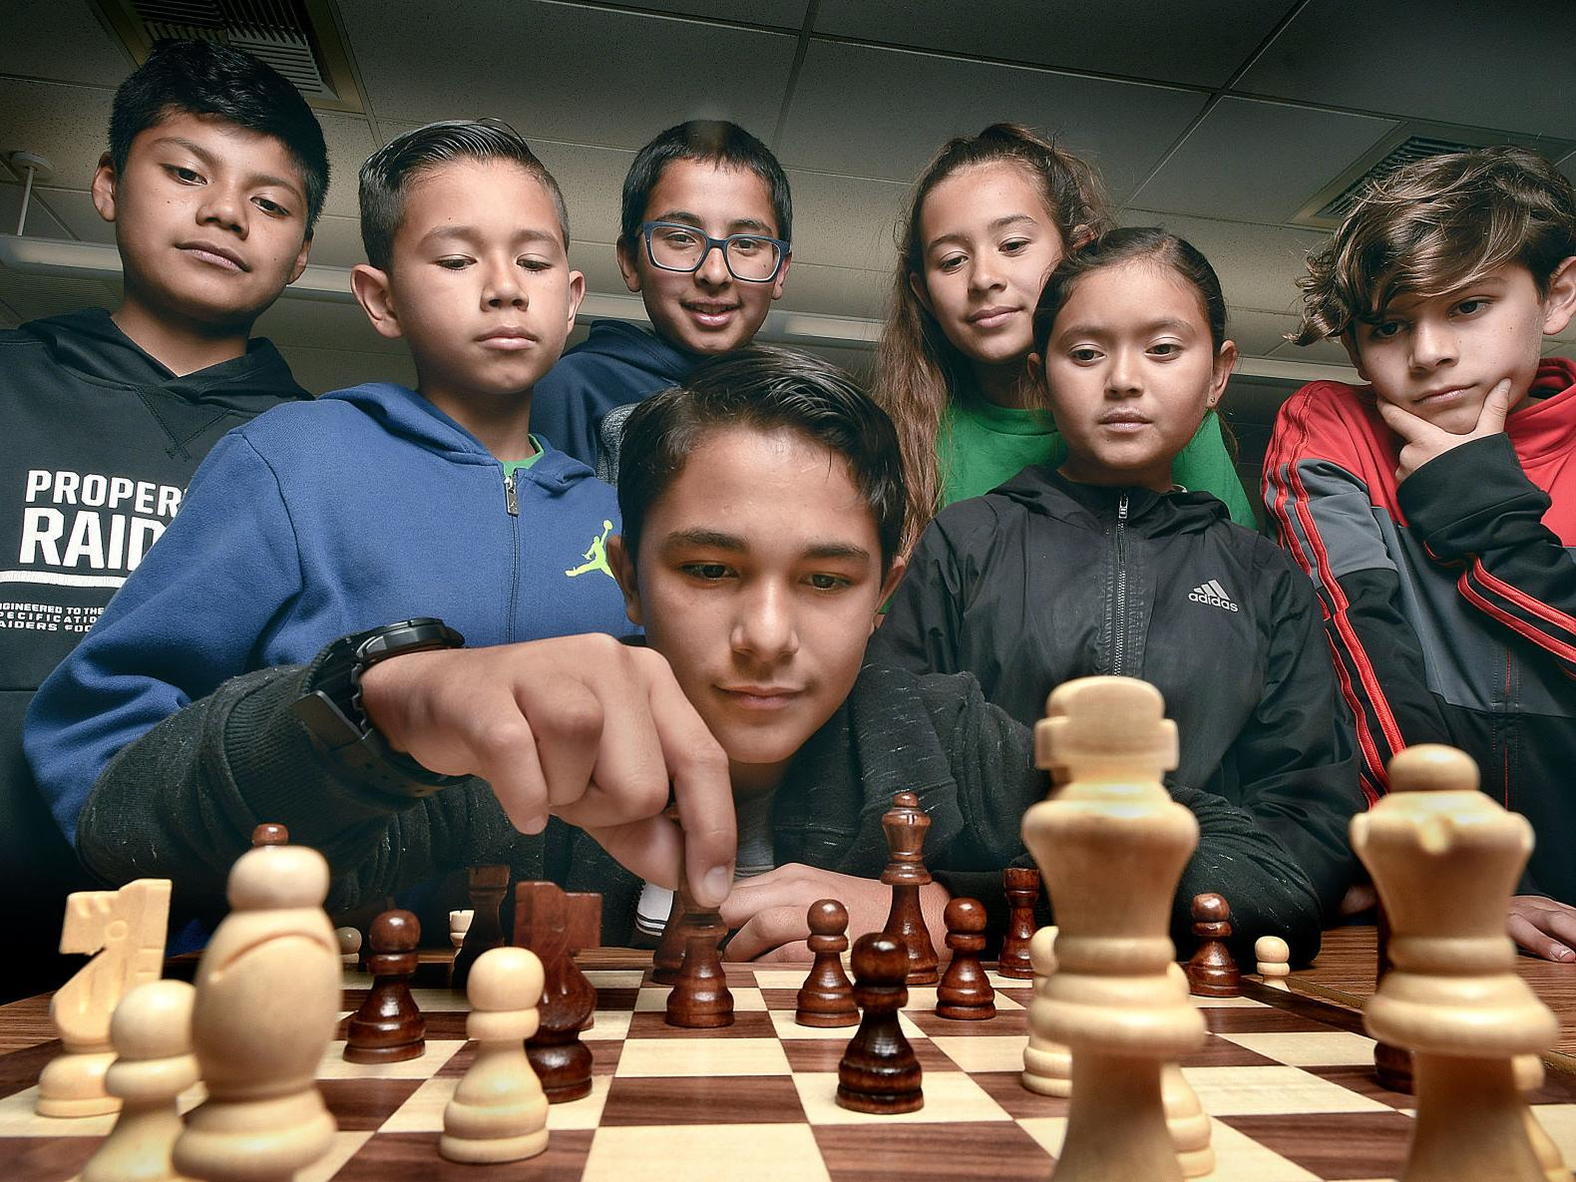
Why did we need a law
Children spend about 7-10 hours a day in school setting
Seizures often occur during the school day
After school programs
  Sports
  Clubs
  ASP

Slide 6
Reopening plans amid pandemic shine light on Florida's school nursing shortage
Some school nurses cover multiple schools at one time
According to the Centers for Disease Control (CDC), schools should have one certified school nurse for every 750 students. In Florida, 2017 school data [the latest available] shows the ratio was one school nurse for every 2,392 students.
According to FDOH, there are approximately 2,286 registered (RN) and licensed practical nurses (LPN) who work in Florida’s 4,200 public schools. An additional 1,431 health aides also help fill the gap but without the qualifications of an RN, campus RN’s are often assigned to cover multiple schools at a time
Osceola County reports it has a nurse assigned full time to serve all 60 of its schools, but that's not the case for many other school districts.
In Seminole County, there are 20 registered nurses for 58 schools that who after 67,000 students.
Orange County has more than 215,000 students and 199 schools. The county employs 110 nurses, a combination of registered nurses and licensed practical nurses.
Clinic assistants in Seminole County and school health assistants in Orange County support nurses daily but not all have a health care background
The Miami-Dade County Public Schools (M-DCPS) educates over 345,000 students in 392 schools and is the fourth largest school district in the nation

Slide 7
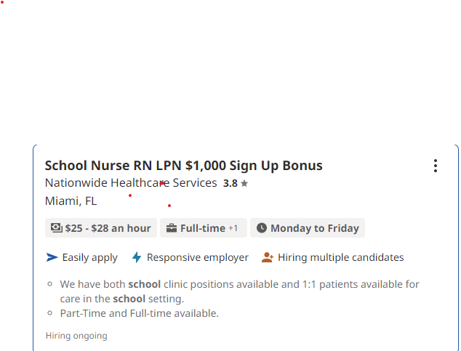
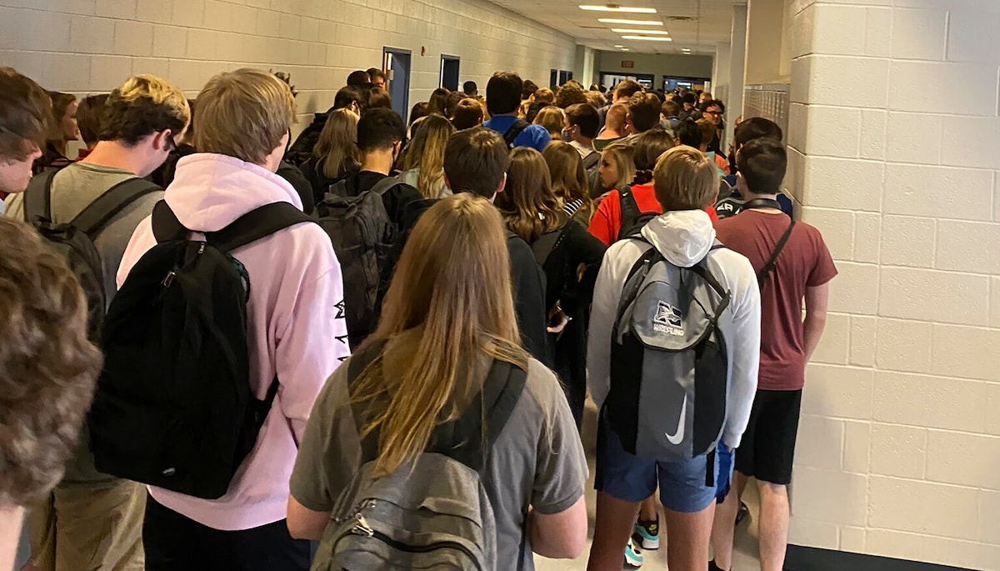
Would you work for this salary?

Slide 8
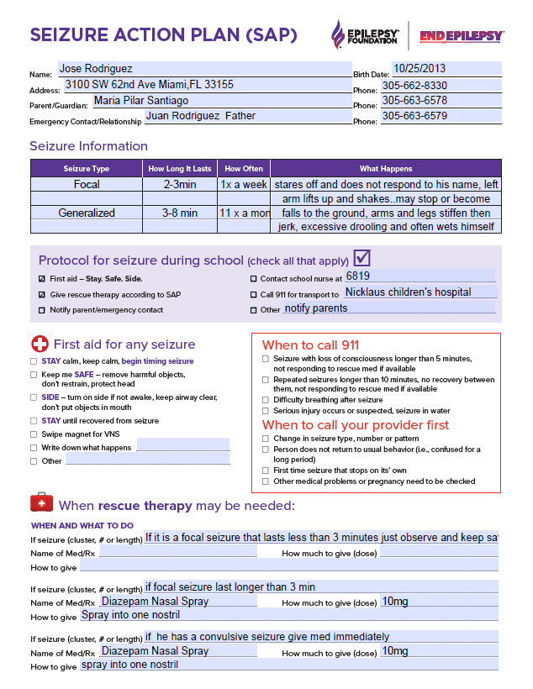
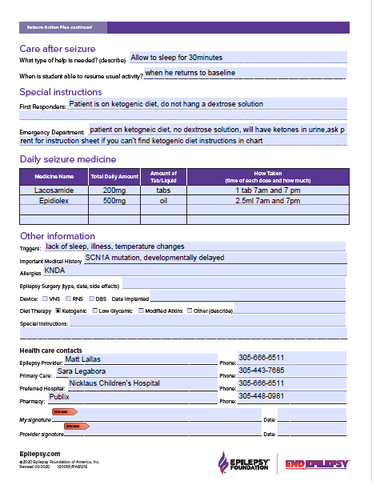

Slide 9
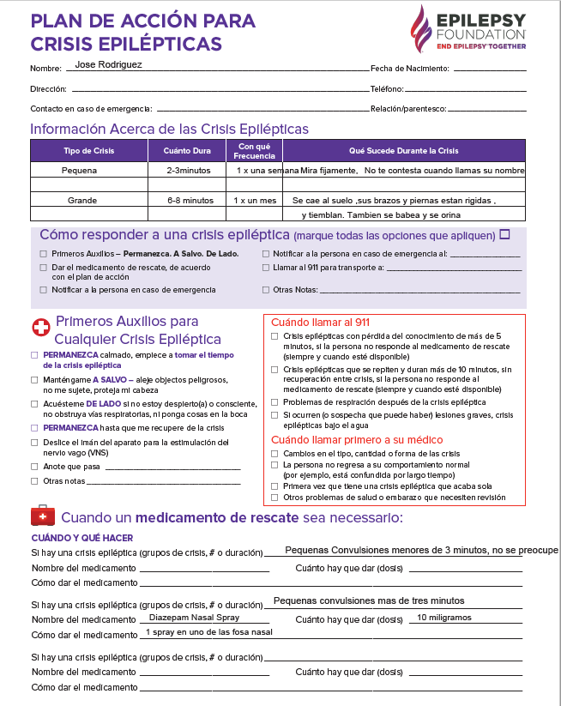
Family preferred language Spanish
Preferred terms for describing seizures not clinical description
Shared with extended family & friends
SAP Example For Family

Slide 10
https://epilepsyalliancefl.org/care-of-students-with-epilepsy

Slide 11
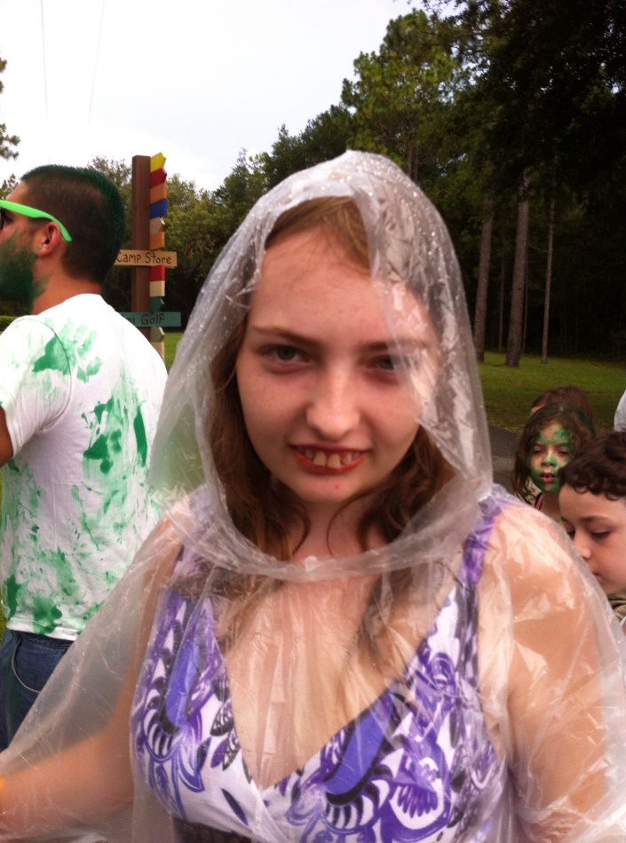
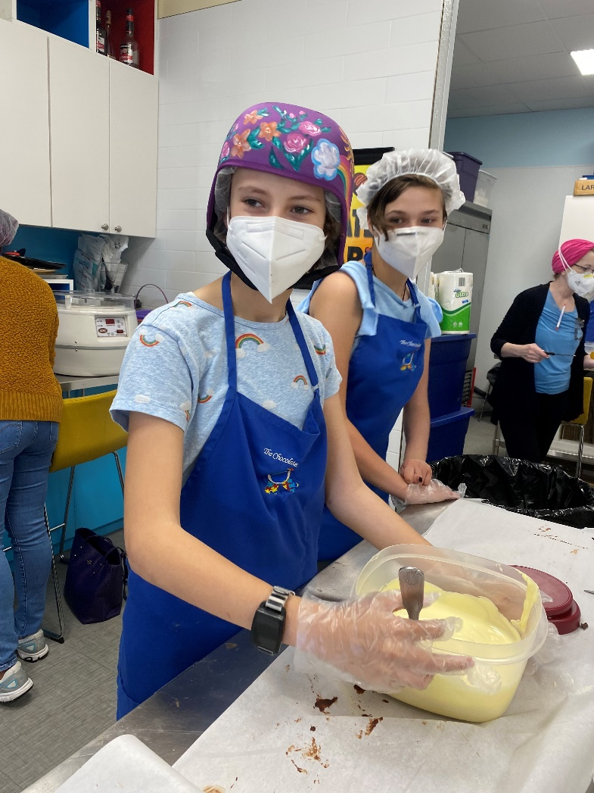
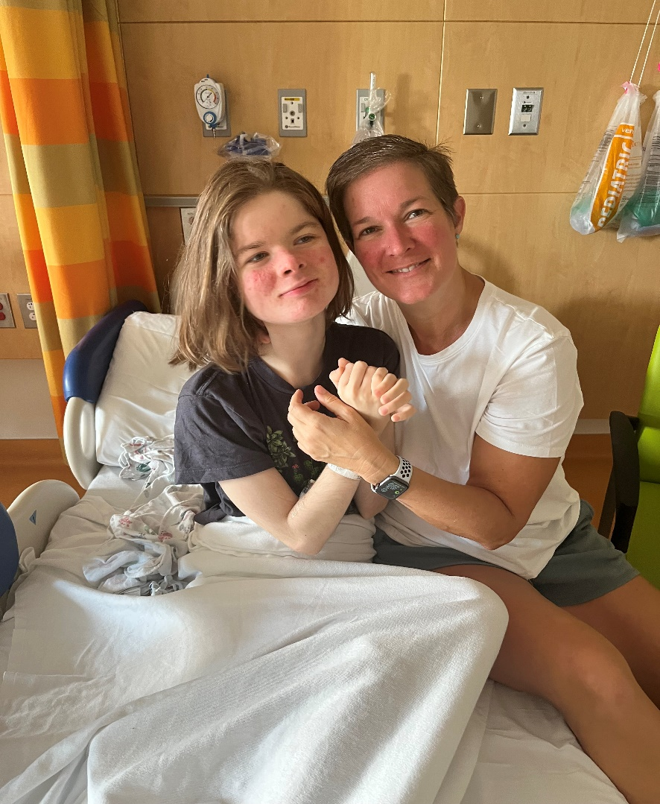
Transitioning the child with a developmental epileptic encephalopathy to adulthood: It’s more than just changing doctors

Slide 12
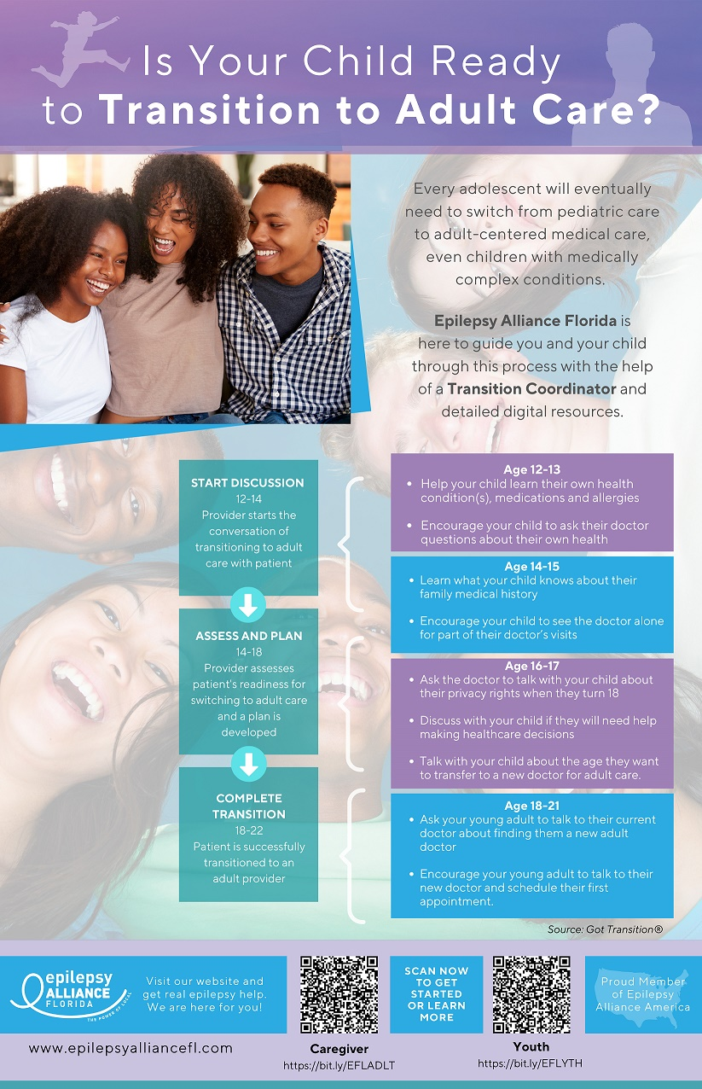
HRSA grant on transition
12-13 know their meds and allergies
Encourage child to talk to doctor
14-15 knows about family medical history
Encourage the child to see doctor alone
16-17 ask the doctor to talk about privacy rights
Discuss with your child if they need help making healthcare decisions
Talk with your child about the age they want to transfer to a doctor for adult care
18-21 have patient talk to their current doctor about finding a new doctor
Encourage them to make their own appointment

Slide 13
Child Neurology Foundation
We begin at ages 12 to 14 to prepare for the change from a “pediatric” model of care—where parents make most decisions—to an “adult” model of care—where youth take full responsibility for decision-making
To accomplish this there will be time during visits with the teen without the parent present. This assists the youth in more independence in their health care.
At age 18, the youth legally become adults. At that time, the young adult’s consent will be required to discuss any personal health information with family members
If the youth has a condition that prevents health care decision making then the parents/caregivers need to consider legal options required to become responsible for the decision-making. This should be accomplished before the youth becomes age 18.
We will work in partnership with youth and families regarding the age for transferring to an adult provider. We do recommend that this occur before age 22.
We will assist with this transfer process, including:
helping to identify an adult provider
sending medical records; and
communicating with the adult provider about the unique needs of each of our patients

Slide 14
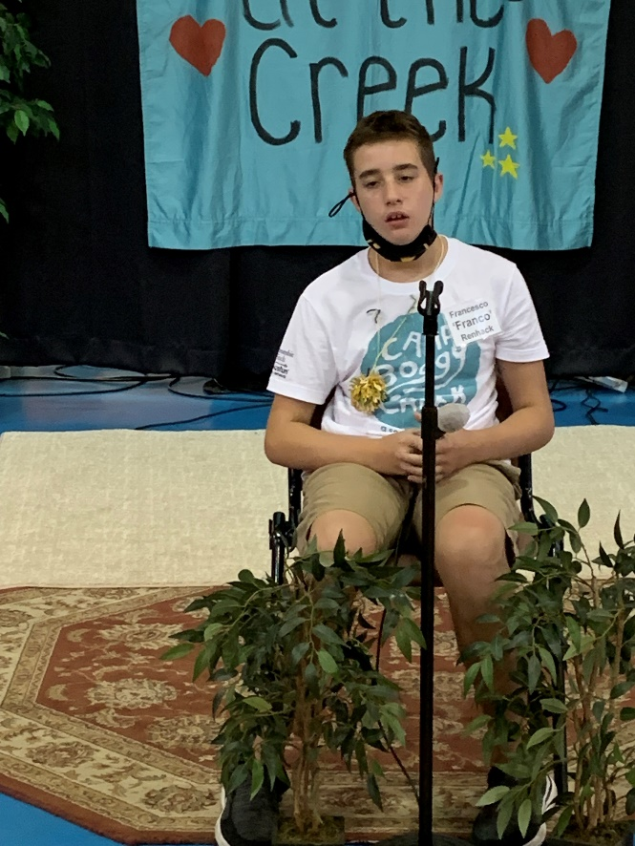
Why you just can’t tell them to find another doctor
Children with complex neurological conditions and intellectual disabilities have unique needs that must be addressed for a successful transition.
As adults, they continue significant caregiver support
They see multiple providers, therapists, case workers participating in a complex web of state specific financial and community services that require orchestration during and after transition

Slide 15
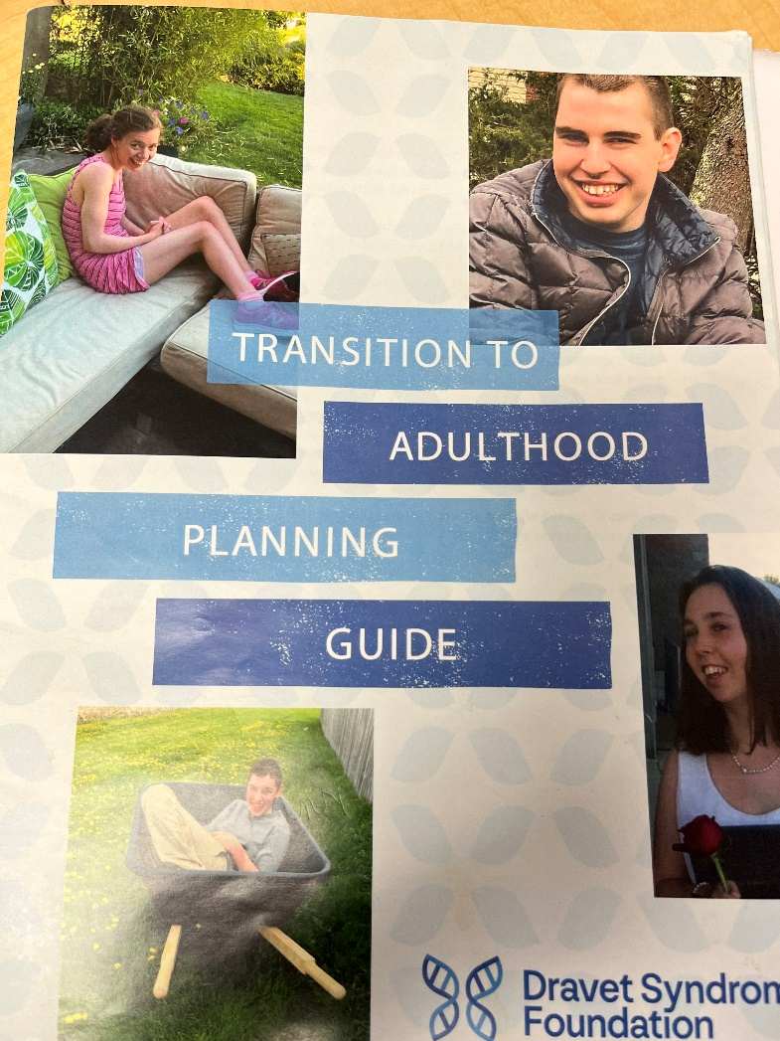
Transition to adulthood planning guide

Slide 16
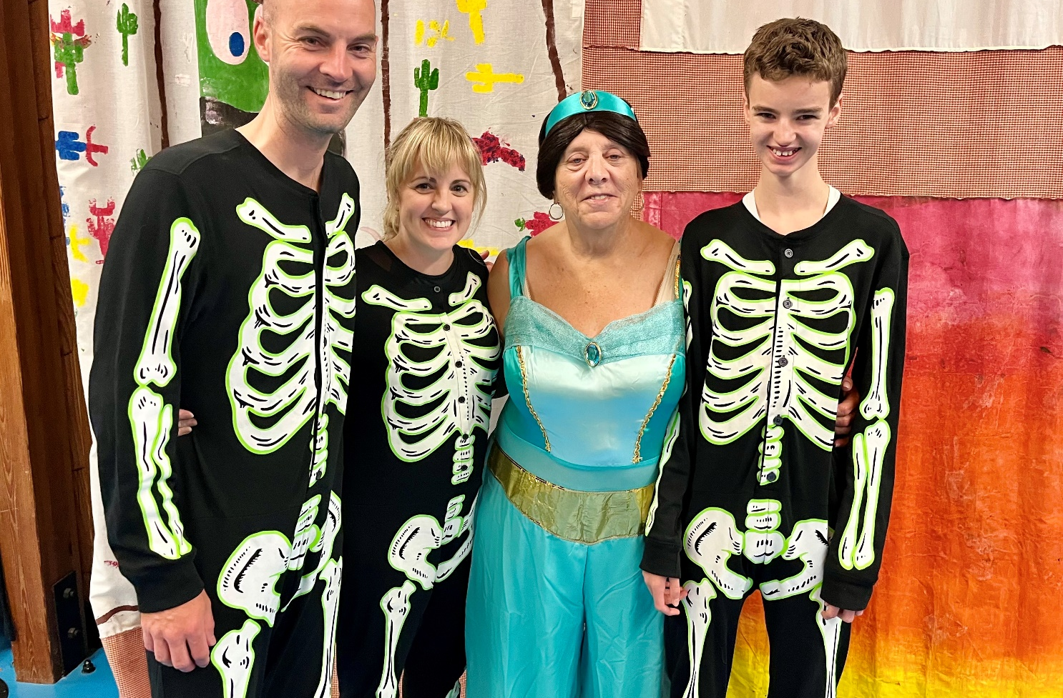
Transition needs to start early
The diagnosis of Dravet and other genetic disorders that result in DEE is a devastating blow to the entire family.
Fear of information on the internet and fear of the unknown course for their child create anxiety and complicates transition planning.
When a child diagnosed at infancy to defer planning until the teen years denies the reality of the situation and sets the entire team up for failure.

Slide 17
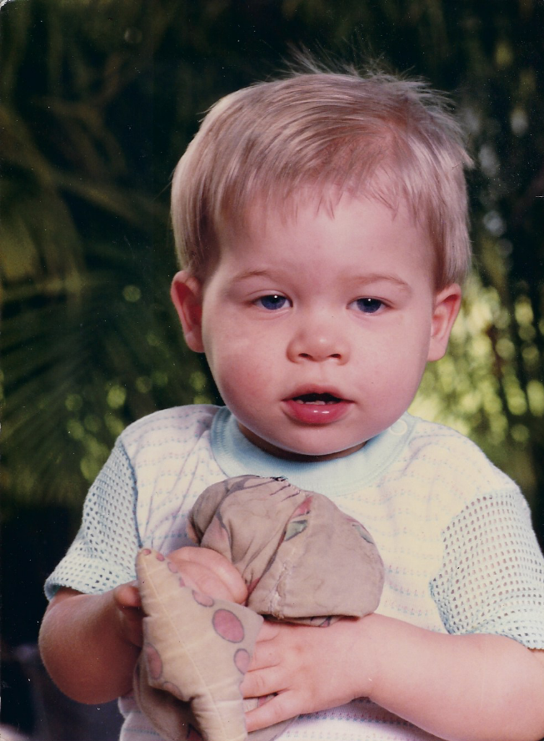
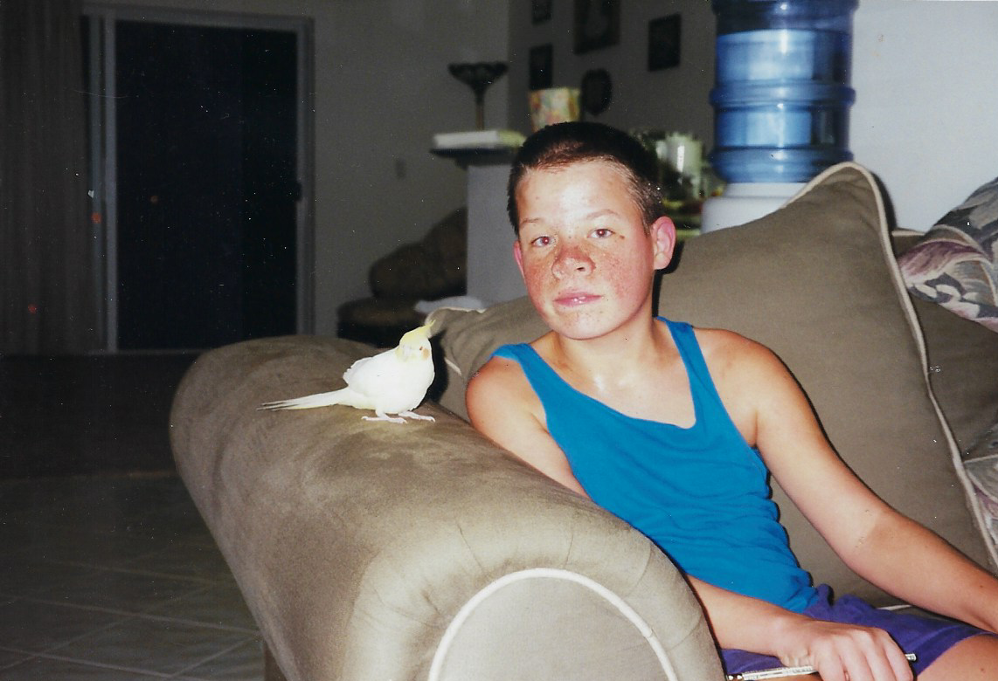
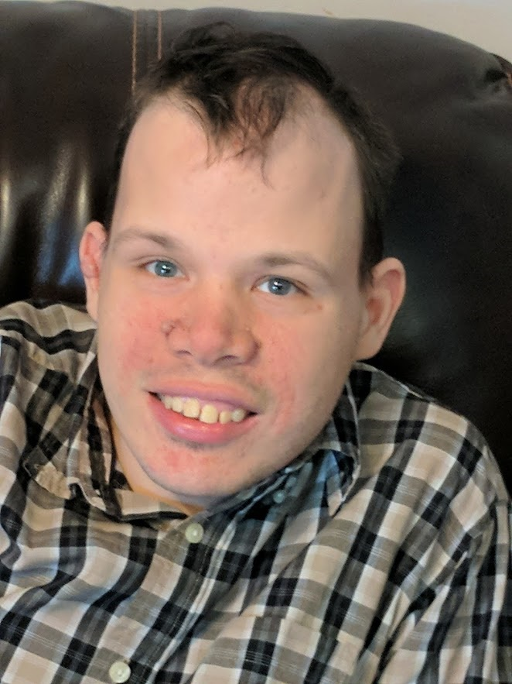
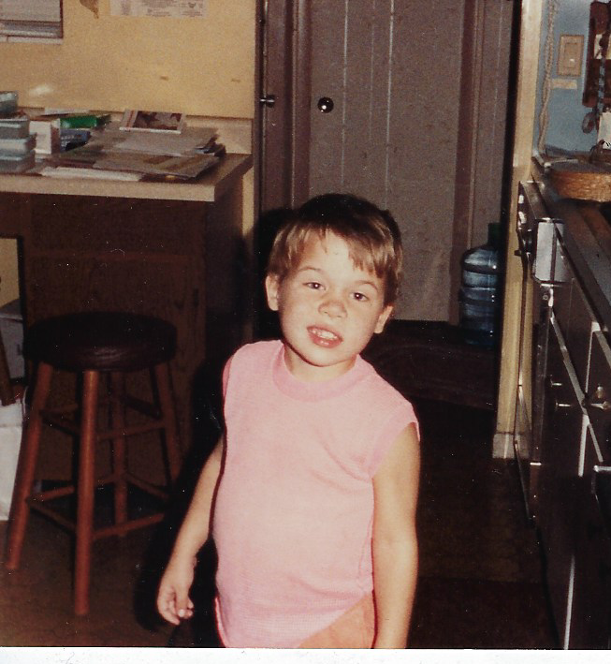

Slide 18
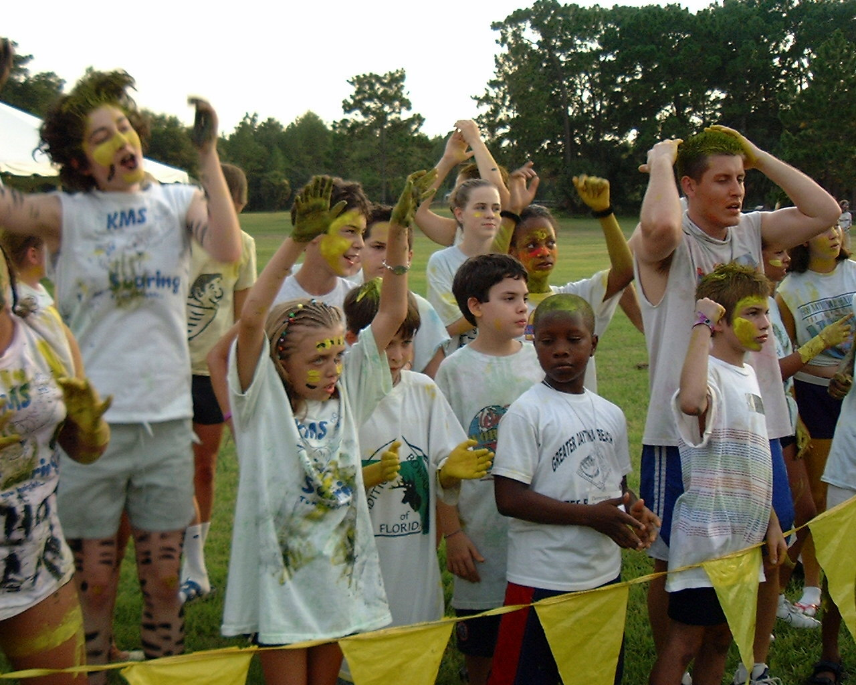
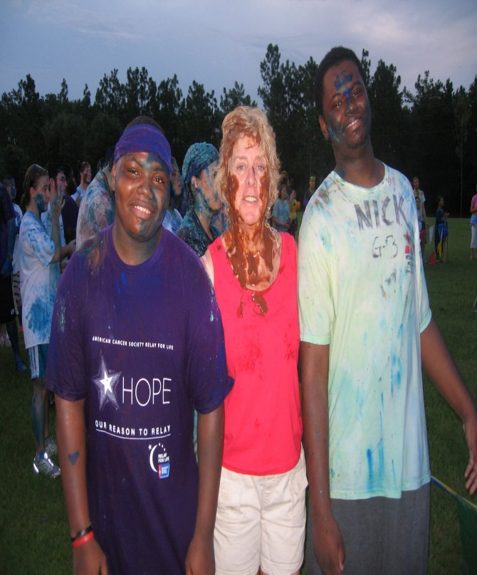

Thank you and Goodbye
Epilepsy Alliance Florida is dedicated to supporting those impacted by epilepsy by confronting the spectrum of challenges created by seizures.

